Slide 1
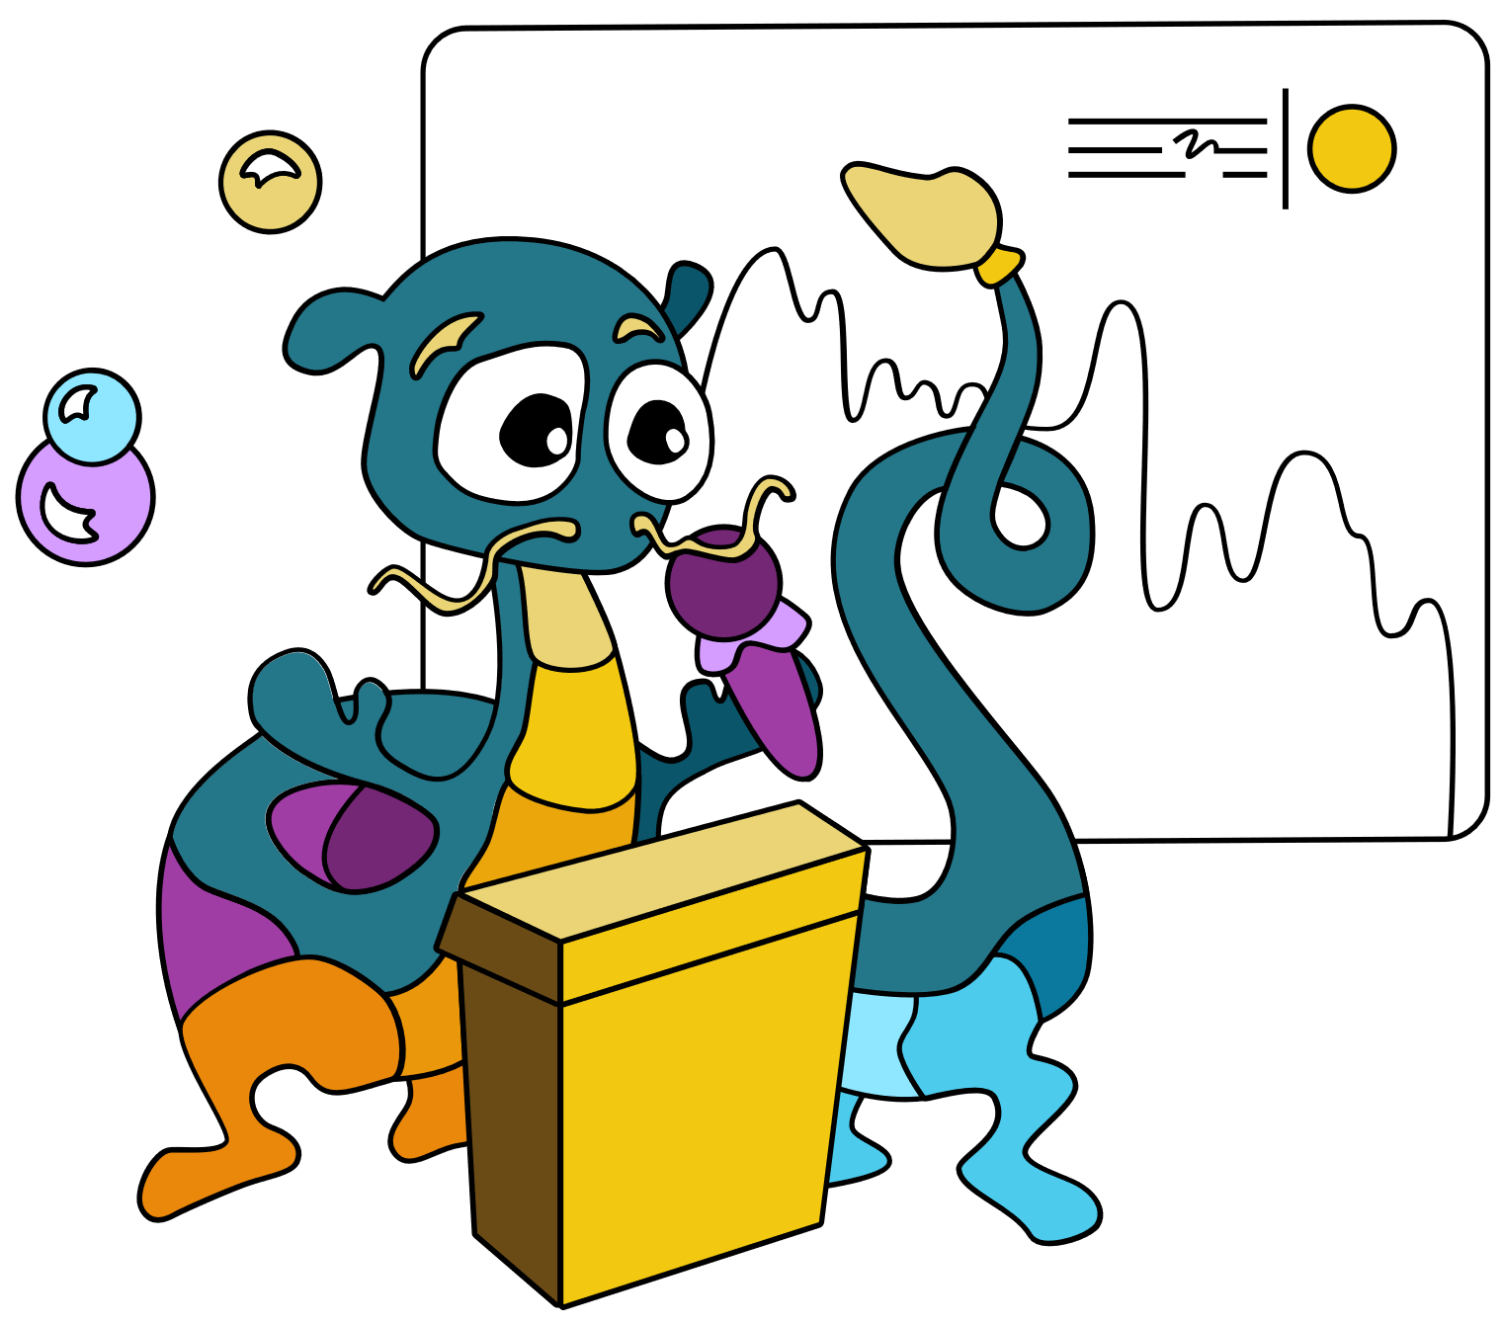

Love at First Sight – Taking your Canvas Apps UI/UX to next level so that Users LOVE your app!
Thu, Sep 22 | 11:00am-12:00pm
Kristine Kolodziejski & David Warner

Slide 2


Slide 3
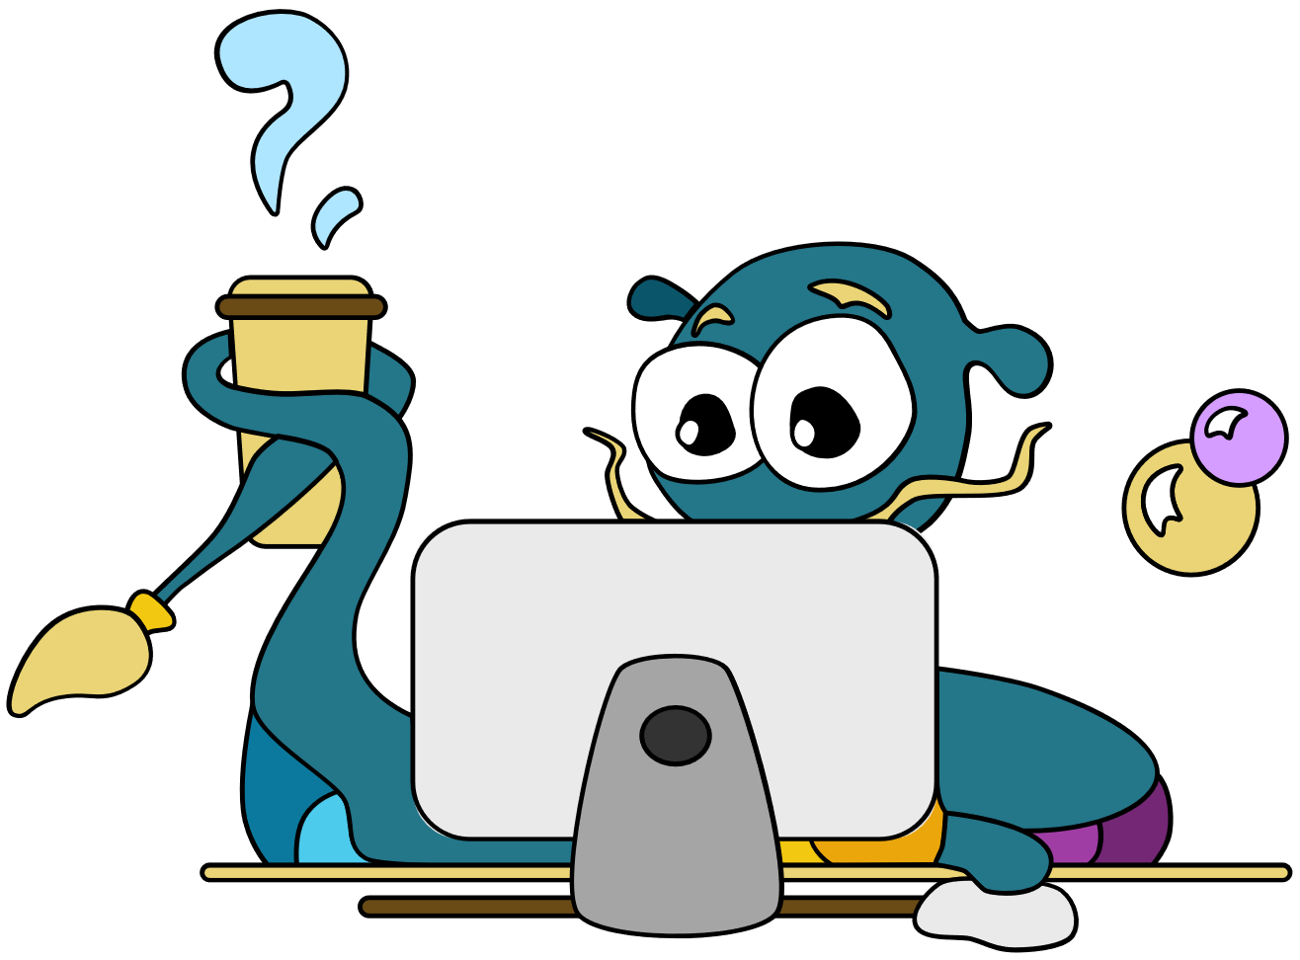



Upskilling for Career Switchers
POWER BI
POWER AUTOMATE
POWER APPS
POWER VIRTUAL AGENTS
POWER PAGES
A brand-new upskilling program for people from non-technical backgrounds, to enable them to get better career opportunities.
Through guided curriculum, self-paced learnings, instructor-led training, and hands-on exercises, participants will learn new skills while being supported by the Power Platform community and Microsoft product teams.
aka.ms/MSPowerUp

Slide 4
JOIN THE COMMUNITY
POWER BI
POWER AUTOMATE
POWER APPS
POWER VIRTUAL AGENTS
POWER PAGES
Discover the difference being part of the Microsoft Power Platform Community can make for you. With the latest News & Announcements, Forums, Microsoft-empowered User Groups, events, and more, you’ll find out why we believe in the power of community. Whether you’re a super user or just getting started, discover why we believe #CommunityRocks!
aka.ms/JointheCommunity

Slide 5
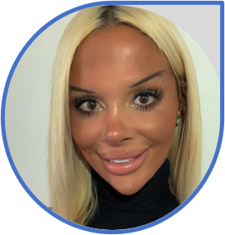
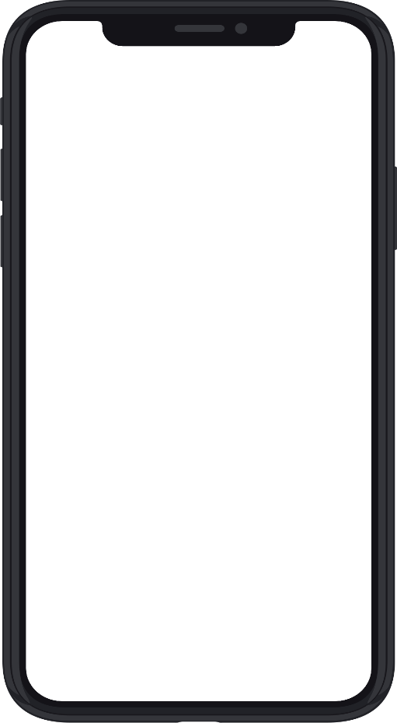
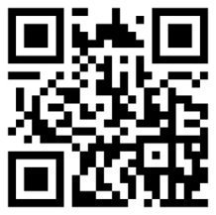

About us
Kristine Kolodziejski
Technical Architect
Computacenter
London, UK
13x Microsoft Certified Professional in Power Platform, Azure and M365
UI/UX obsessed
Active community contributor
Blogger and YouTuber
Avid gamer and dog mum

Slide 6
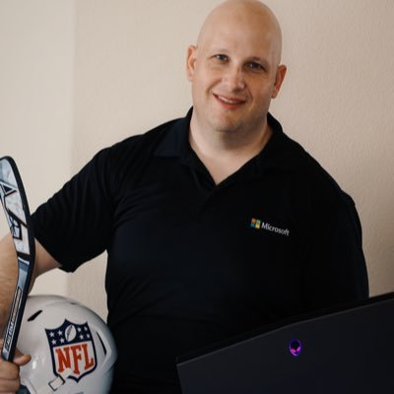
About us
David Warner
Senior Program Manager
Microsoft
California, USA
UI & UX obsessed
Sports fan
Community fan

Slide 7
Don’t judge a book (app) by its cover (design)?
65%
of content paired
with appealing visuals
is remembered
3 days later
90%
of information
sent to the brain
is visual
Coloured
visuals increase
people’s willingness
to interact by
83%
People retain
80%
Of what they see

Slide 8
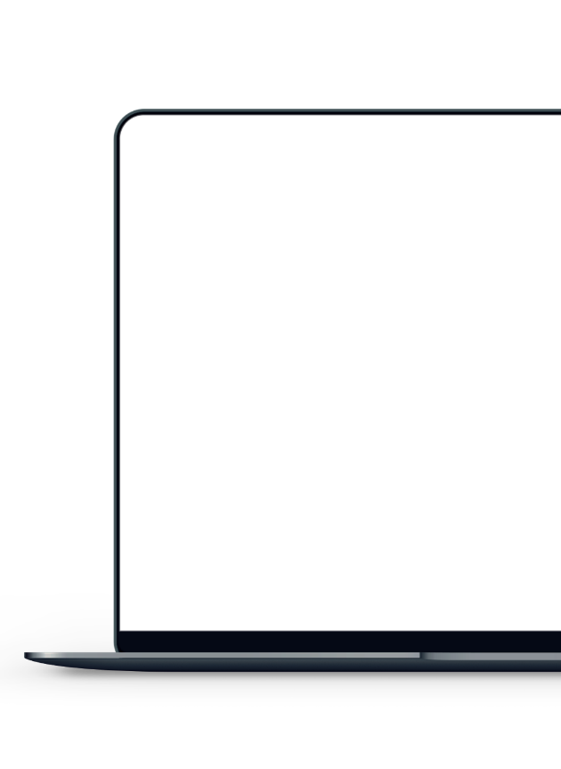
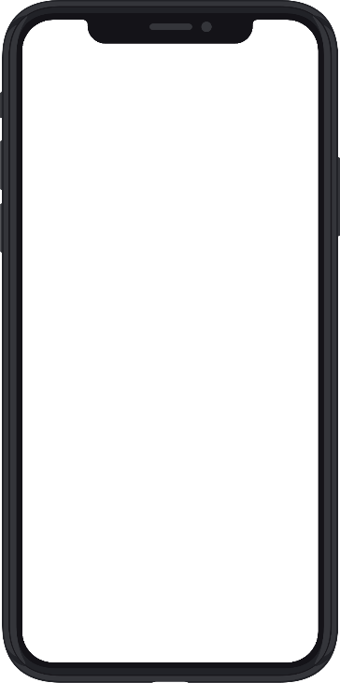
Mobile vs desktop
(web) apps

Slide 9
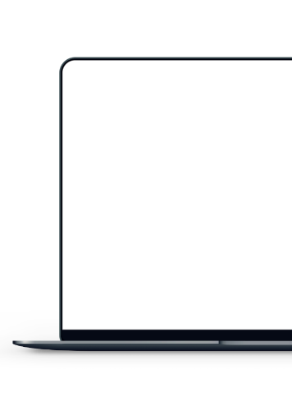

Mobile vs desktop
(web) apps
It’s much easier to design a mobile application and scale up the screen estate
Fast and mobile or complex and time consuming
Cursors and large estate or gestures and small estate
Columns and compartments or long scrolling
Mobile first
User mentality
Content structure
Interaction

Slide 10
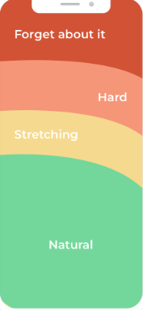
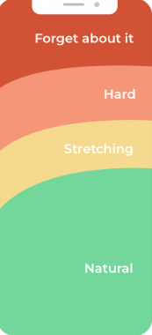
The thumb zone
Left hand
Right hand

Slide 11
Demo time!

Slide 12
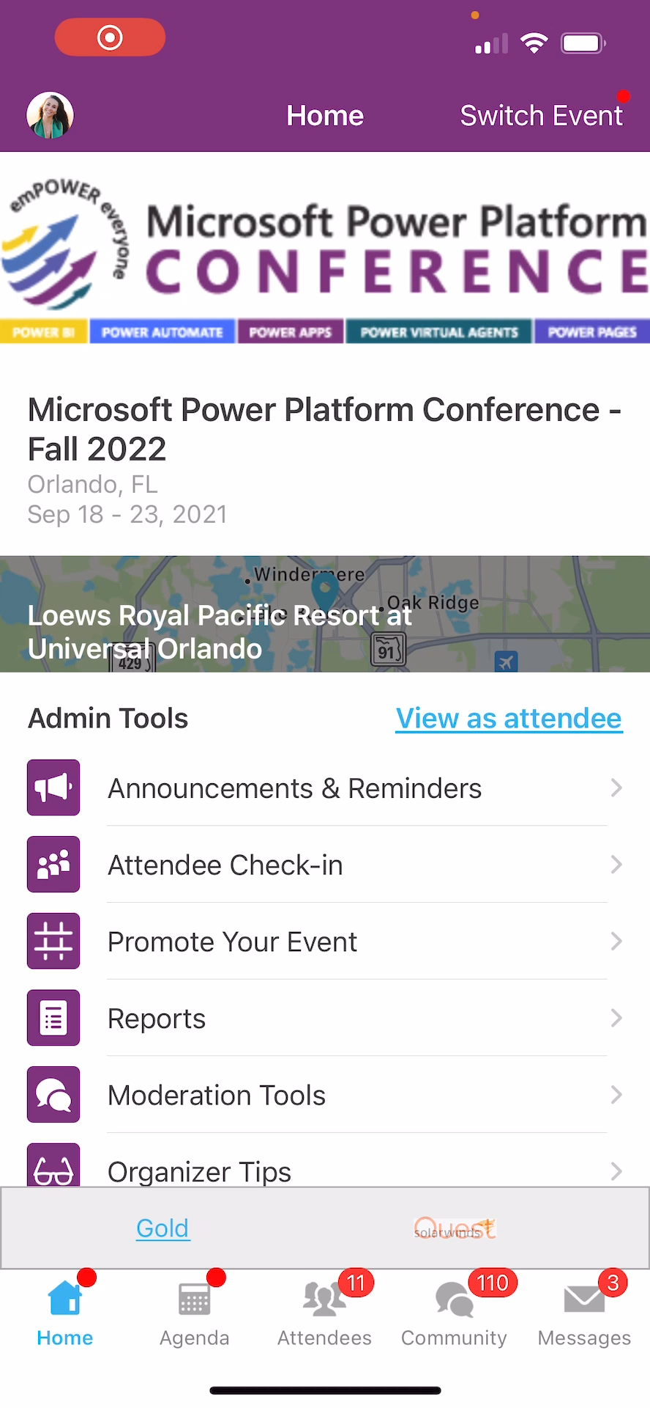
Session Feedback Surveys
In the pursuit of making next year’s Microsoft Power Platform Conference even better, we really want to hear your feedback about this session.
Here’s How -
Simply go to the Whova App on your smartphone
Go to the Microsoft Power Platform Conference event
Scroll down on the homepage to ‘Additional Resources’ and click ‘Surveys’.
Click ‘Session Feedback’.
Scroll down to click on this session title.
Complete the session feedback survey.
Finally, click ‘Submit’

